Slide 1
Literature Reviews
Molly Hoch & Jane She

Slide 2
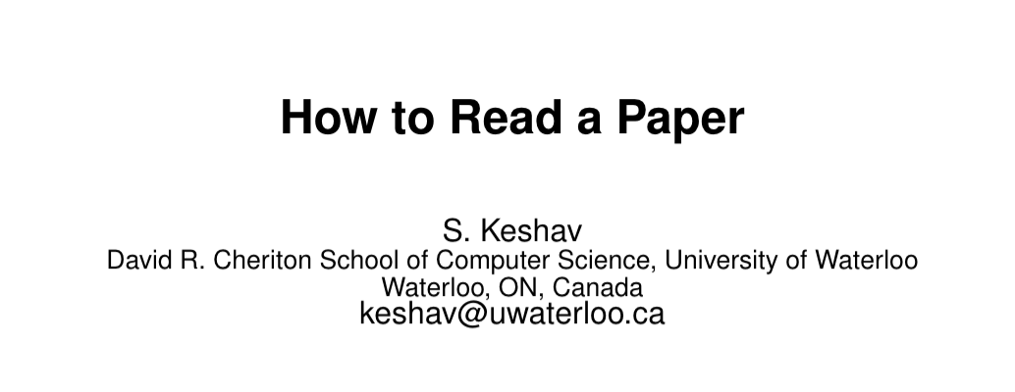
The art of reading a scientific paper
Notes:
Will be sent out in an email after lab

Slide 3
The art of reading a scientific paper
First pass: birds eye view
Headers + conclusion
Choose whether or not to keep reading
Second pass: read closer but ignore details
Figures, try to summarize
Third pass +: attention to detail

Slide 4
Forced Audience Participation: What strategies work for you when reading papers?
Notes:
read intro & methods first, skip over sim results on first read; look through sims to see other comparator methods
Have a purpose: what are you looking for? What are you trying to understand?
Read connected papers while keeping original in mind

Slide 5
Finding Papers to Read

Slide 6
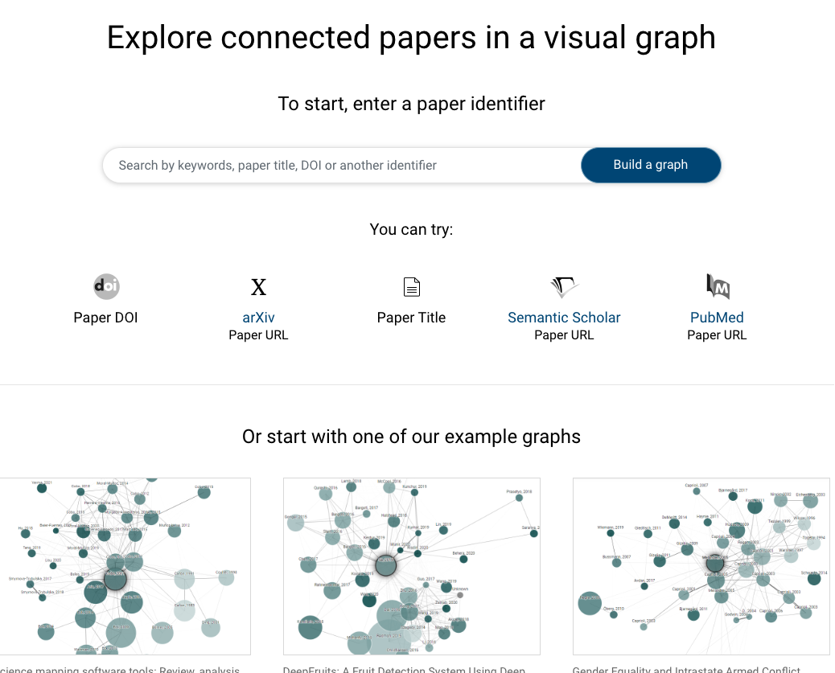
Finding Related Papers: connectedpapers

Slide 7
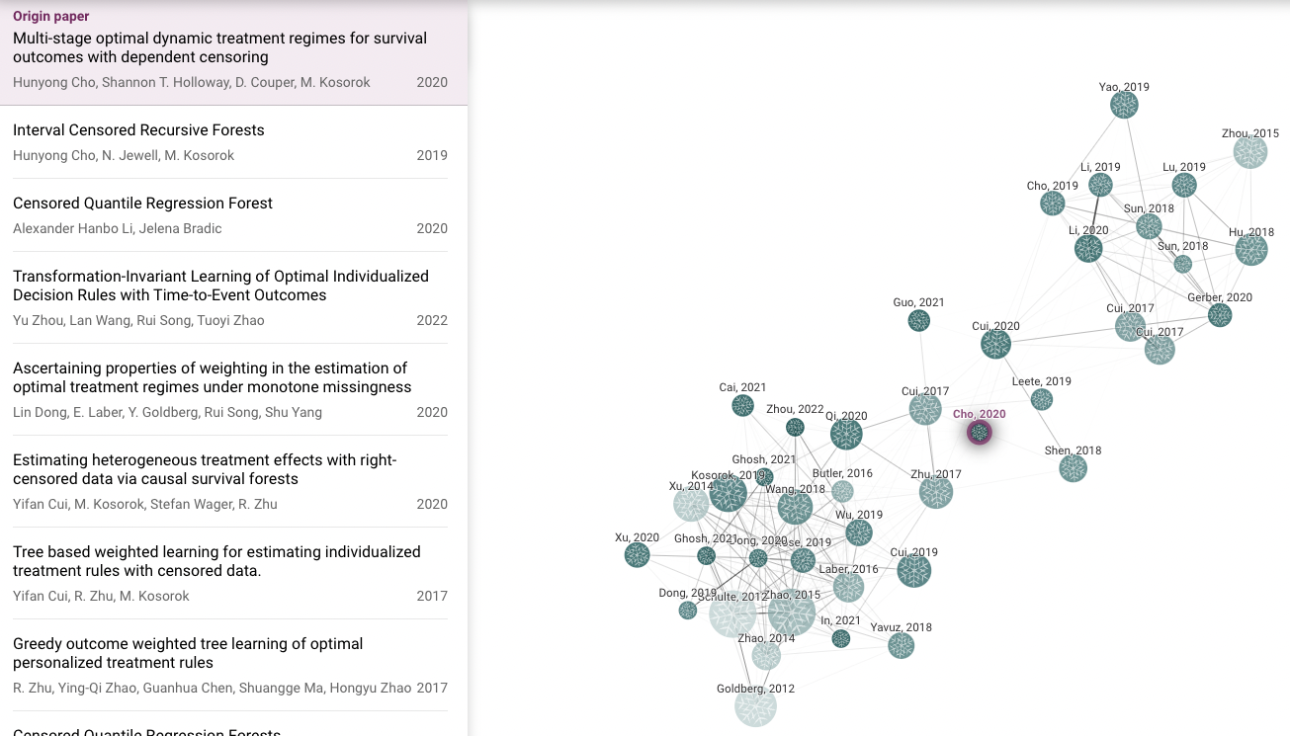
Finding Related Papers: connectedpapers
Notes:
Similar papers cluster together
Node size indicates number of citations

Slide 8
Similar Websites to Consider
https://www.litmaps.com/features#discover
https://inciteful.xyz
Notes:
Incitetful: can seed multiple papers to refine your search & groups of papers recommended to you
See common citations & how two papers are connected
Can see “first” “kernel” papers in literature you’re reading

Slide 9
Forced Audience Participation: What is your strategy to finding papers? Has that changed through the years?
Notes:
Google searching or bing; sometimes there are people discussing your ideas who don’t have papers for it yet
Looking at references on a paper you are reading

Slide 10
Other ways to find papers
Google scholar
Looking at citations from papers you’re reading now
Conference proceedings

Slide 11
How to manage the papers you’ve read
Citations: Zotero
Others?
Mendeley
Saving papers on google scholar
Paperpile (works w/ google docs & word too)
Notes: Obsidian
Others?
Notion (similar to obsidian)
Excel (onedrive to access from anywhere)
Can have excel sheet listing all the papers within a topic
List summary, main idea, journal, drawbacks, etc.
Sciwheel (can save papers you’re looking at)
Browser add-on, can add labels
Notetaking capabilities & can link to original paper
UNC libraries pay for everyone to have access & have learning resources
Can help with review papers (tracking agreements & disaggreement)

Slide 12
Using ChatGpt to help understand papers

Slide 13
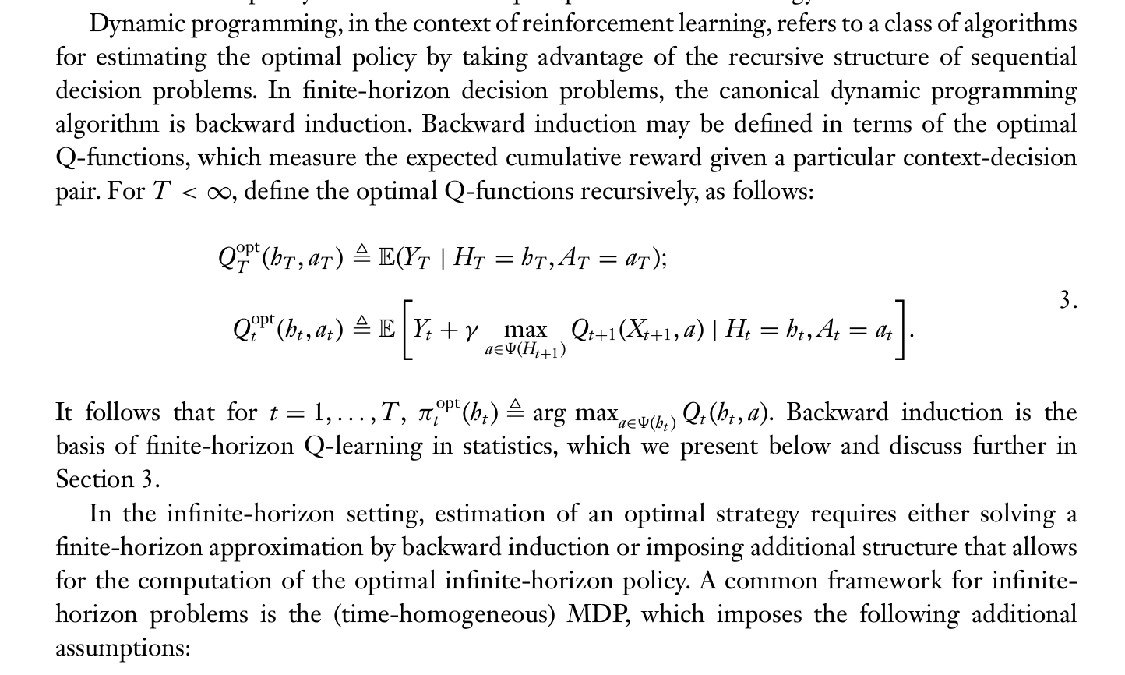
Using ChatGpt to help understand papers
Excerpt from Clifton & Laber Q-Learning: Theory and Applications (2020)
Notes:
Excerpt from a paper I was reading

Slide 14
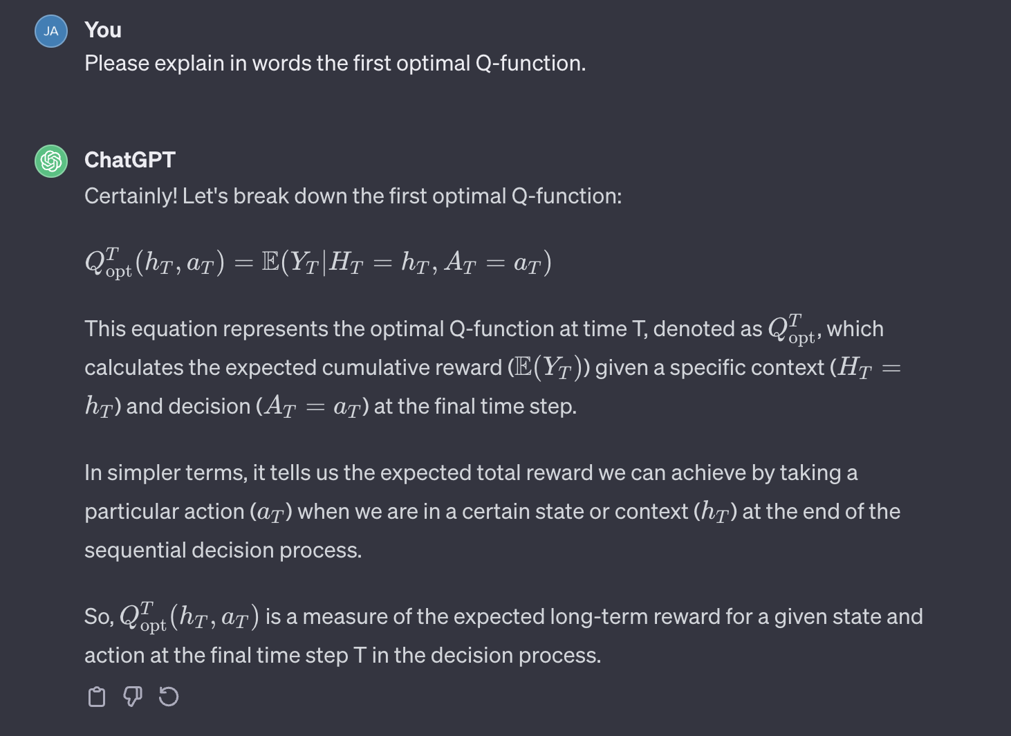
After copying & pasting into chatgpt…
Be cautious!
Notes:
I have had experiences doing so where chat GPT gave me an answer that didn’t seem quite right. Upon questioning/clarification it then corrected itself
From john: ChatGPT 4 can be better (less likely to make stuff up)

Slide 15
Using chatgpt to help understand code

Slide 16
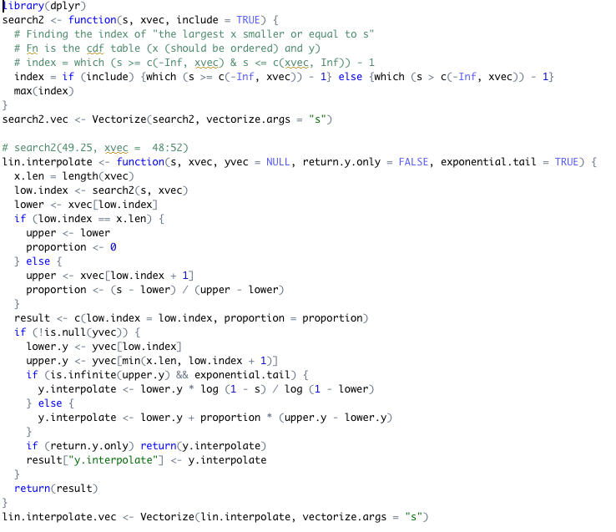
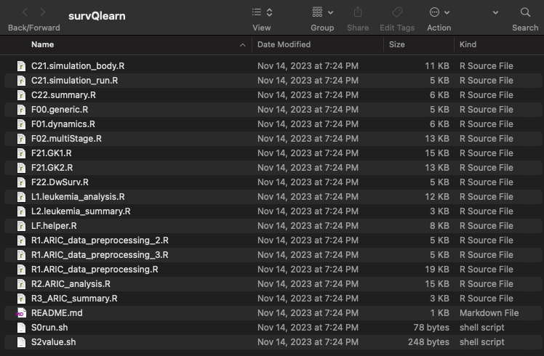
Using chatgpt to help understand code
Lots of functions, lots of scripts
Source: survQlearn package by Dr. Cho

Slide 17
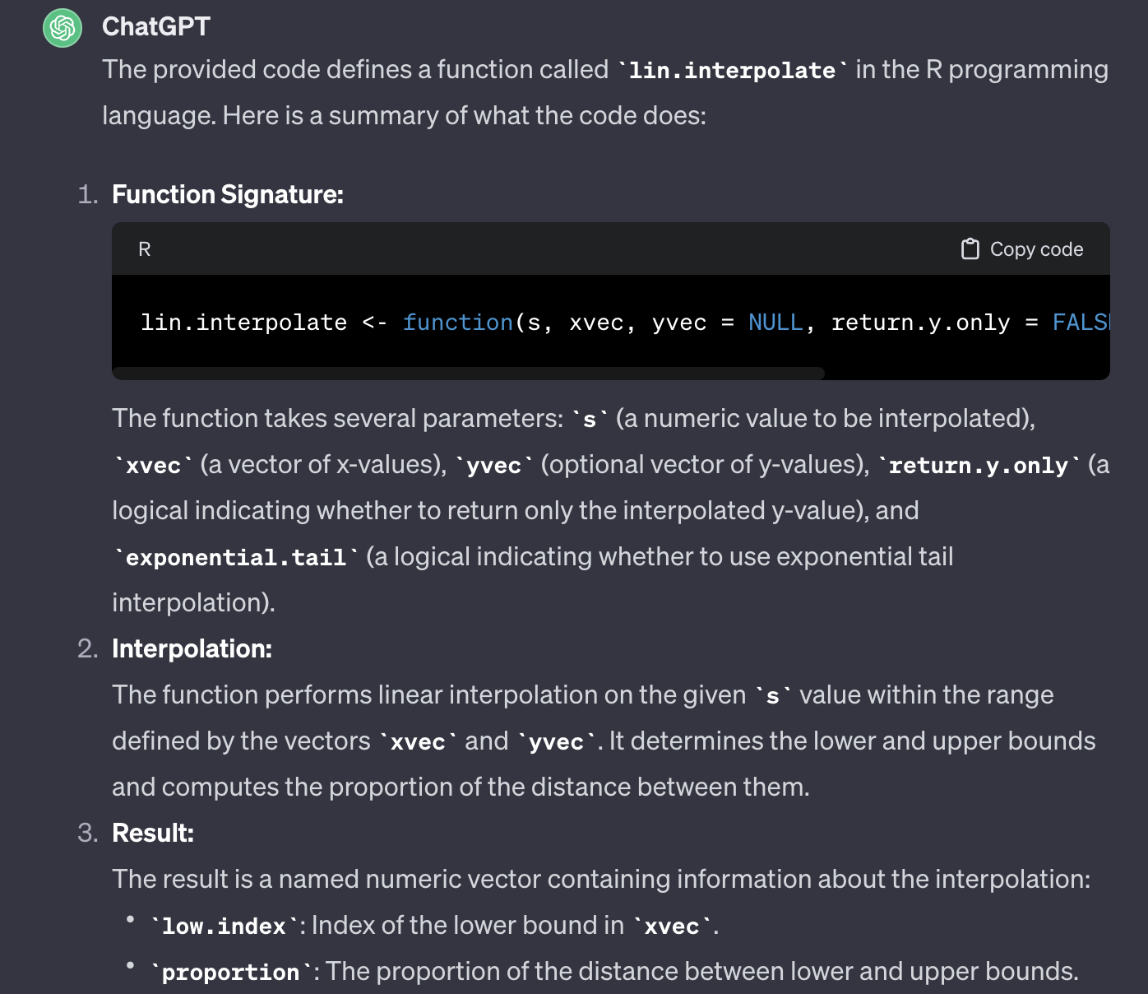
ChatGPT, ”Please summarize what the following code does”

Slide 18
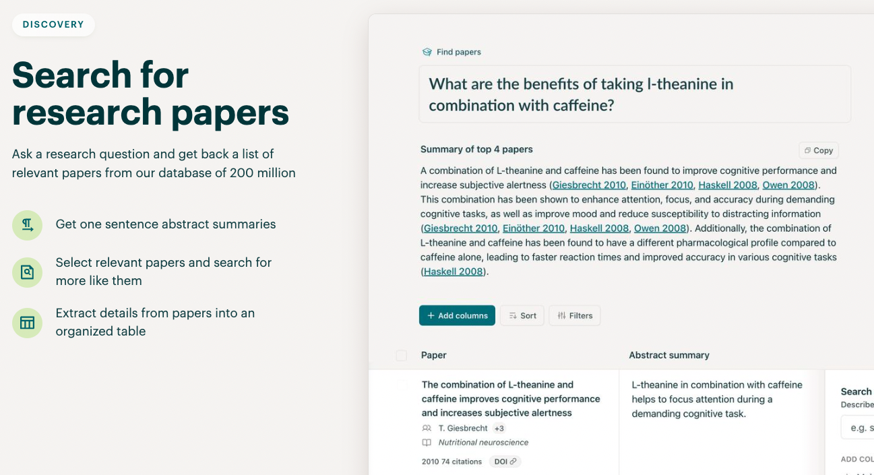
Using Elicit to help you understand papers (requires account)
Notes:
I have not tried this but it looks cool

Slide 19
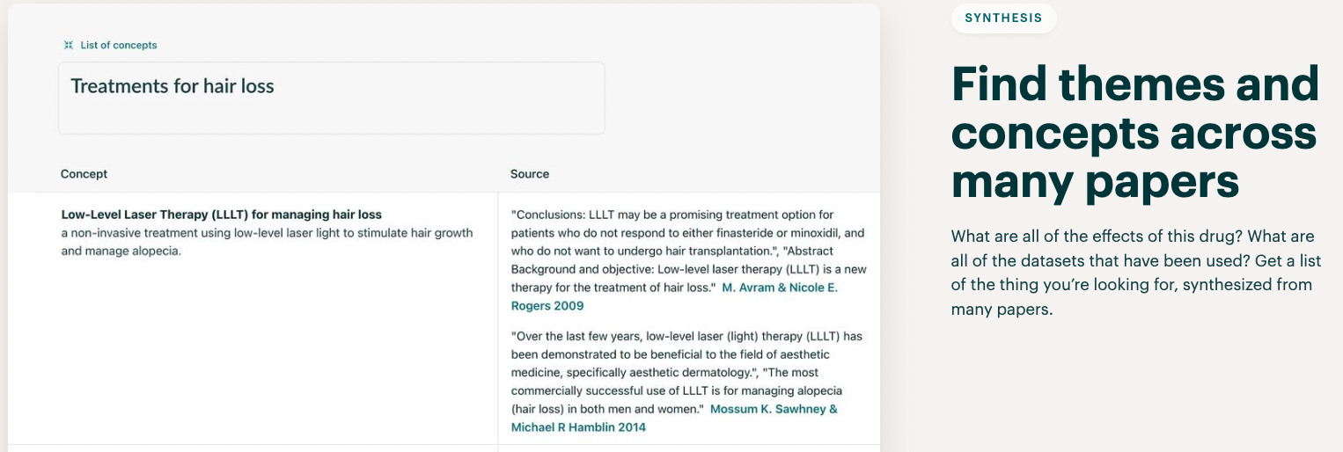
Using Elicit to help you understand papers

Slide 20
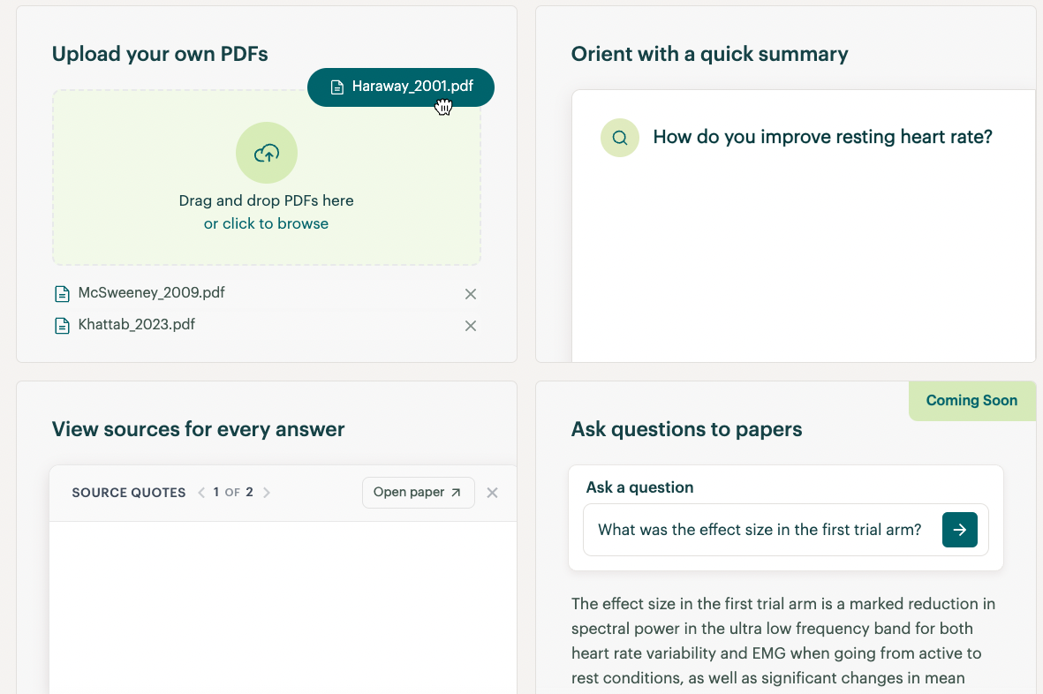
Using Elicit to help you understand papers

Slide 21
General advice
Paper appendices for proofs (not in the main results)

